Slide 1
Person-centred HIV patient monitoring and birth defect surveillance programme
Thokozani Kalua MBBS MSc
Malawi Ministry of Health
Notes:
Reality

Slide 2
Background
First line regimens
d4T (40), 3TC, NVP and d4T (30), 3TC, NVP
TDF, 3TC, EFV
TDF, 3TC, DTG
Choice of first line regimens
Efficacious
Available as a fixed dose combination
Safe in pregnancy and in patients with TB
Tolerable

Slide 3
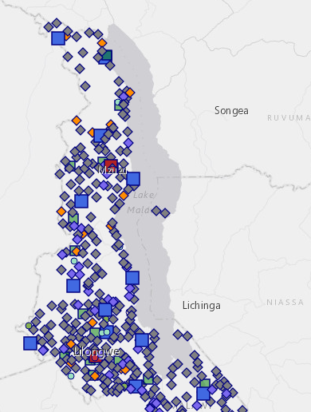
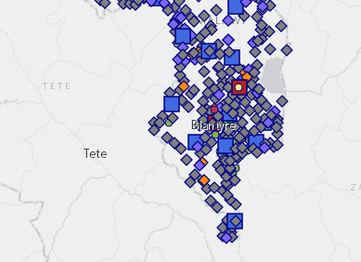
Program built on public health approach
Minimal laboratory monitoring
No baseline laboratory monitoring
Decentralized
739 sites (2018 Q1)
Limited infrastructure capacity
Weak health workforce
Numbers and expertise
Task-shifting
Simple integrated guidelines
Simple M&E tools
Manual and electronic
Support clinical decision-making

Slide 4
Evolution of the ART program
Better drugs
More potent; more durable; convenient; better tolerated; and fewer drug interactions
Increasing access
Option B+ in 2011, universal eligibility (2016)
760,000 PLHIV on ART

Slide 5
Monitoring of ARVs in settings with health system challenges
Standard clinic monitoring checklist for screening
Electronic medical records to aid clinical decisions
55% of patients at a site with EMRS
Supervision of health care workers
Important with task-shifting
Pharmacovigilance

Slide 6
Pharmacovigilance
Dedicated chapter introduced with Malawi Guidelines for Clinical Management of HIV in Children and Adults, 4th Edition
Critical system intervention
Public health approach – rapid scale-up
Longer life on ART due to efficacy
Early adopters
Rapid availability of medicines to the market with need for further monitoring during implementation
Especially in some population groups

Slide 7
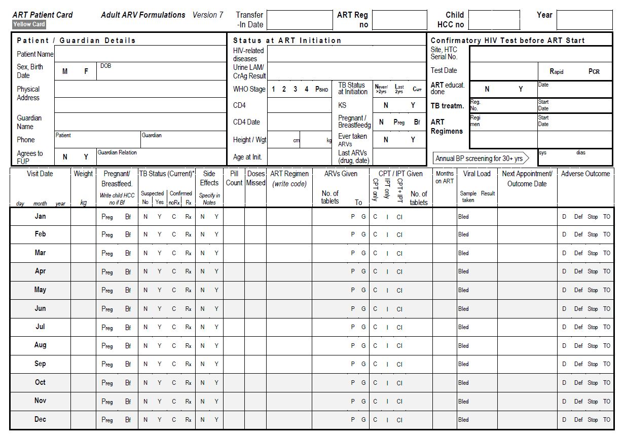
Manual patient records

Slide 8
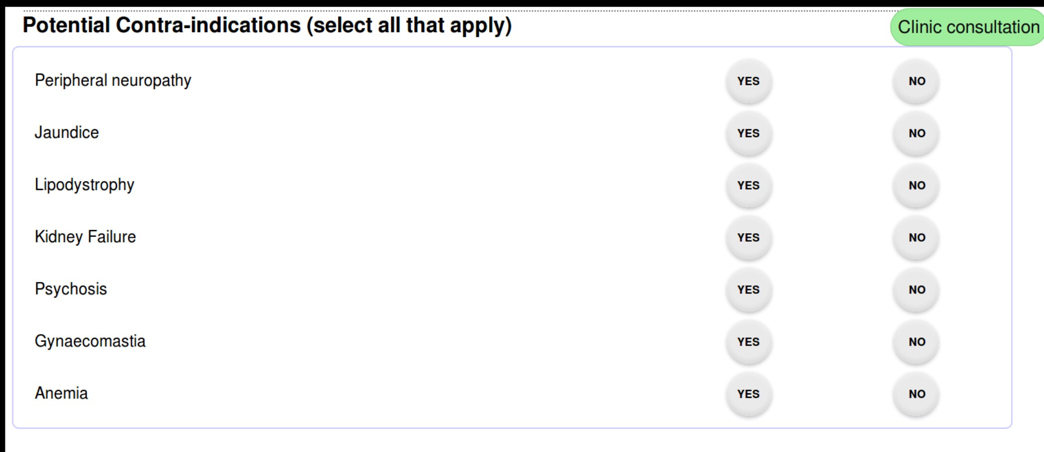
Electronic medical records (example)

Slide 9
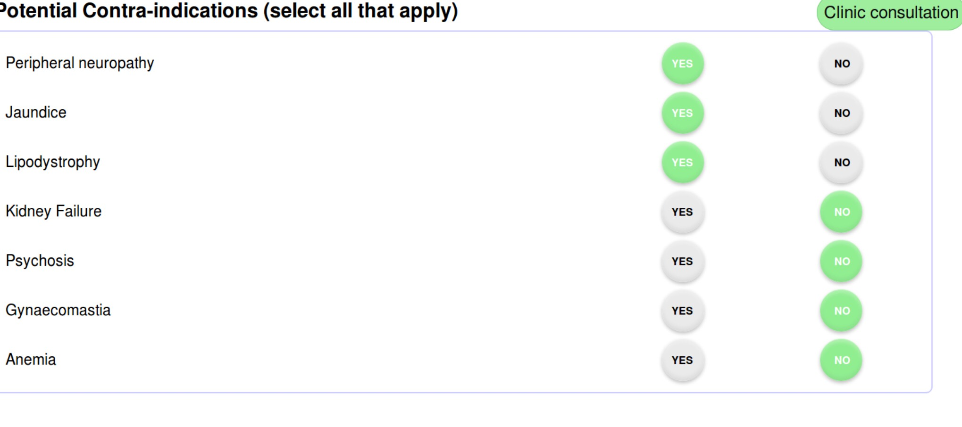
Electronic medical records (example)

Slide 10
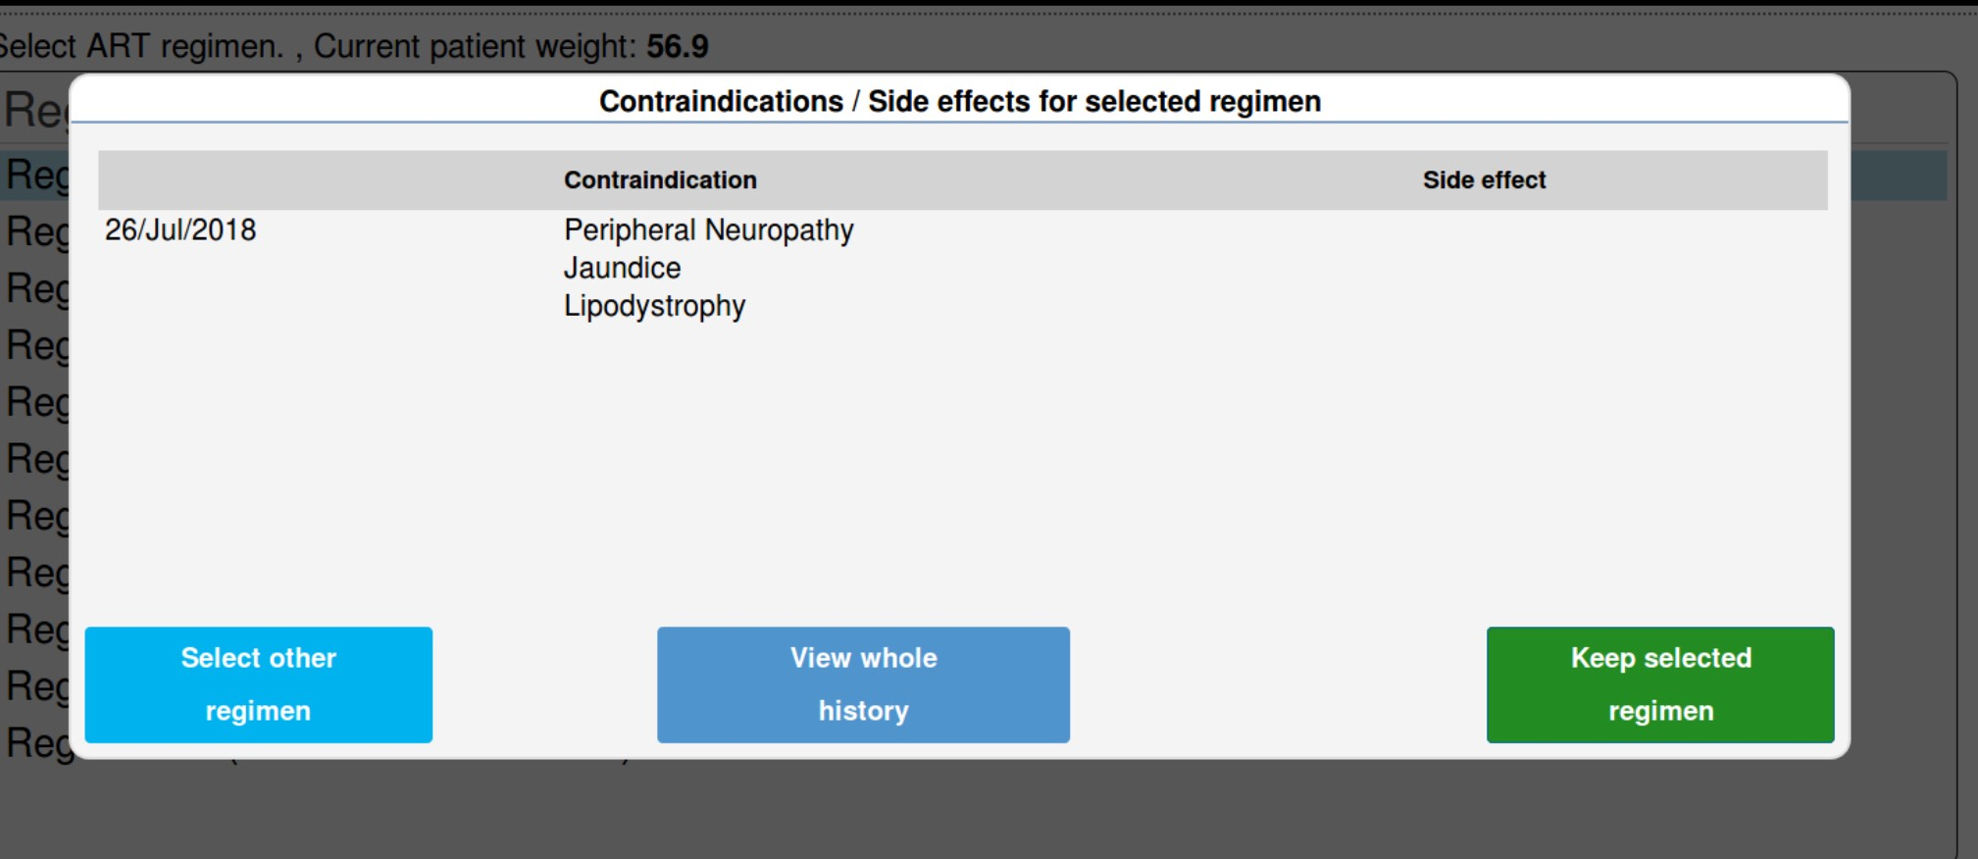
Electronic medical records (example)

Slide 11
Challenges
Monitoring is mainly clinical and not laboratory
Reporting is basic
Under-reporting
About 1% of patients reported to have any side effect

Slide 12
Opportunities
Price reductions of medicines
Free up resources that can be used to strengthen health systems and to set up monitoring systems?

Slide 13
Birth defects surveillance
Ongoing
Recruited 21.9% of study target
0.57% had a major birth defect

Slide 14
Way forward
Need for monitoring of ARVs still remain
Need to develop robust integrated systems for patient monitoring and systematic reporting
Routine
Active
Need to strengthen health systems

Slide 15
Thank you for listening

